Slide 1
Multi-Token Prediction with Consistency Method
Selective Distribution Consistency + Latent Consistency Matching
Reporter：陳九龍
1

Slide 2
CONTENTS
01
04
Introduction
Experiment results
Page 4 ~ Page 7
Page 17 ~ Page 24
05
02
Related works / MTP
Conclusion
Page 9 ~ Page 11
Page 26 ~ Page 27
03
Proposed method
Page 13 ~ Page 15
2

Slide 3
Introduction
ONE
3

Slide 4
Part1: Introduction
Background — Multi-token prediction for faster generation
MTP 的目標：一次 forward 不只預測下一個 token，也讓多個 draft models 預測更遠的 future tokens。
Input: t₀
Model
(target + draft)
Output: t₁… t_{k}
核心假設：若 draft 的預測與主模型一致，self-speculative decoding 就能一次接受多個 token，降低實際推論成本。
Draft model 預測越遠的 token 看到的訓練目標越困難，因此 PPL 通常快速升高。
Draft model 預測越遠的 token 更加難被 target model 接受。
4

Slide 5
Part1: Introduction
Motivation — deeper draft model are harder to optimize
標準 MTP 只用 CE loss 訓練每個 target, draft model，但不同 model 之間缺少明確的一致性約束。
問題 1
Draft model 預測越遠，PPL 越高
問題 2
Target model accepte tokens 不穩定
問題 3
生成品質無法最大程度提升
研究焦點：在不改變 MTP baseline 架構的前提下，用 consistency-method 強化 draft model。
5
Notes:
consistency-method 無強調 motivation 描述太簡要
畫圖

Slide 6
Part1: Introduction
Research goal
Goal：在既有 MTP 架構上加入 selective distribution consistency 與 latent consistency，使 model 同時改善 PPL、acceptance 與 generative quality。
MTP baseline
Add SDC
(KL with confidence)
Add LCM
(latent matching)
Train on 10B openwebtext
Evaluate
PPL / GenPPL / Accept
• SDC：用 teacher distribution 約束 student，並用 confidence mask 過濾不可靠 token。
• LCM：在 embedding / hidden representation 層級進行一致性對齊。
• SDC+LCM：同時對齊 token distribution 與 latent representation。
6

Slide 7
Part1: Introduction
Contributions
01
Selective Distribution Consistency
將 consistency regularization 轉成適合 MTP draft model 的 KL loss。
02
Confidence-aware distillation
只在 teacher confidence 足夠的位置進行分佈蒸餾，避免噪聲。
03
SDC + LCM joint training
同時約束 token-level distribution 與 latent representation，改善生成品質與接受率。
7

Slide 8
Related works / MTP
8

Slide 9





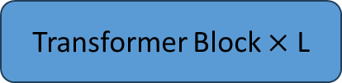







Part2: Related works / MTP
Multi-Token Prediction architecture
Output Token
$$t_{1}^{1}$$
$$t_{2}^{1}$$
… …
$$t_{T}^{1}$$
$$t_{2}^{2}$$
$$t_{3}^{2}$$
… …
$$t_{T+1}^{2}$$
$$t_{k}^{k}$$
$$t_{k+1}^{k}$$
… …
$$t_{T+k−1}^{k}$$
Position-wise FFN
MTP Head 1
MTP Head 2
MTP Head K
Transformer Block
Transformer Block
Transformer Block
… …
Shared Trunk Network
hidden layer
Transformer Block $×$ L
Embedding Layer
Head 1 對應標準 next-token prediction (target model)。
Head 2~K 對應 draft model。
模型架構重點：計算成本主要集中在 shared trunk；多個 heads 的額外成本相對較小，因此可用於 draft token prediction。
Embedding Layer
Input Token
$$t_{0}$$
$$t_{1}$$
… …
$$t_{T−1}$$
9
Notes:
上標括號

Slide 10
Part2: Related works / MTP
Baseline training
未加入 consistency 時，每個 head 只根據自己的 target offset 計算 CE loss。
Forward
Backward
CE Loss 1
CE Loss 2
… …
CE Loss K
z = model.shared(x)
d = z.detach()
d.requires_grad = True
for i in range(n):
p = model.head[i](d)
loss(p, y[i]).backward()
z.backward(gradient=d.grad)
Head 1
Head 2
… …
Head K
Shared
優點：架構簡單，與標準 LM 訓練流程相容。
限制：Head 2~K 的 distribution 可能與可靠 teacher / Head 1 不一致。
10

Slide 11





Part2: Related works / MTP
Self-speculative decoding
Propose + verify
Head 1(target model)中的t₂,t₃標記為$t_{2}^{T},t_{3}^{T}$
Situation 1: $t_{2}^{D}≠t_{2}^{T}$
Head 3:
t₃
t₄
t₅
t₆
退化為NTP, 不產生draft token
Head 2:
t₂
t₃
t₄
t₅
Output Token:
t₀
t₁
t₂
Head 1:
t₁
t₂
t₃
t₄
Situation 2: $t_{2}^{D}=t_{2}^{T},t_{3}^{D}≠t_{3}^{T}$
Model(K = 3)
Draft Token:
t₄
t₅
Output Token:
t₀
t₁
t₂
t₃
t₄
t₅
Input Token:
t₀
t₁
t₂
t₃
Situation 3: $t_{2}^{D}=t_{2}^{T},t_{3}^{D}=t_{3}^{T}$
假設t₂,t₃是draft token標記為$t_{2}^{D},t_{3}^{D}$
Draft Token:
t₅
t₆
Output Token:
t₀
t₁
t₂
t₃
t₄
t₅
t₆
11
Notes:
刪掉

Slide 12
Proposed method
THREE
12

Slide 13
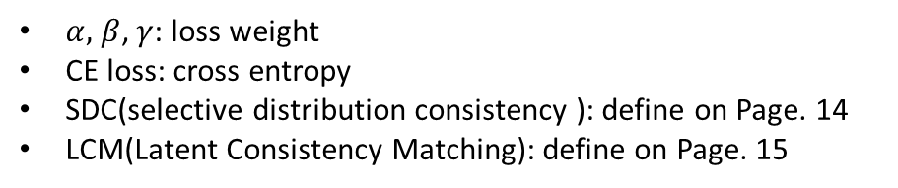

Part3: Proposed method
Method overview
本研究將 MTP CE loss 與 SDC / LCM consistency loss 結合，對齊 teacher和student 在probability與latent的分佈。
Forward
Backward
Teacher probability/latent
Student latent
Student probability
Add
… …
Add
CE Loss 1
CE Loss 2
LCM Loss 2
SDC Loss K
… …
CE Loss K
LCM Loss K
SDC Loss K
Head 1
Head 2
… …
Head K
$$L_{total}={α∙L}_{CE}+{β∙L}_{SDC}+{γ∙L}_{LCM}$$
Shared
$α,$ $β$, $γ$: loss weight
CE loss: cross entropy
SDC(selective distribution consistency ): define on Page. 14
LCM(Latent Consistency Matching): define on Page. 15
13

Slide 14
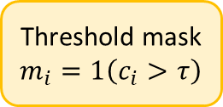
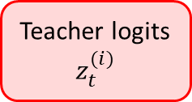
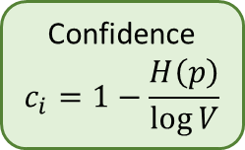
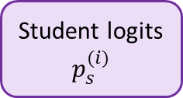
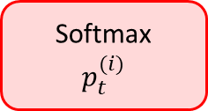
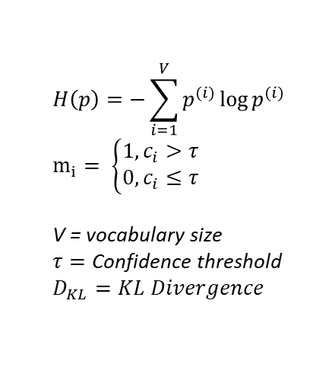
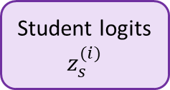
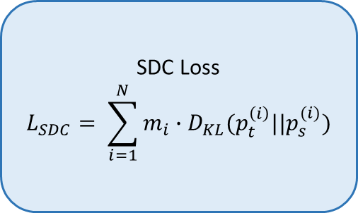
Part3: Proposed method
Selective Distribution Consistency — confidence-aware KL
Teacher logits
$$z_{t}^{(i)}$$
Softmax
$$p_{t}^{(i)}$$
Confidence
$$c_{i}=1−\frac{H\left(p\right)}{\log{V}}$$
Threshold mask
$$m_{i}=1\left(c_{i}>τ\right)$$
SDC Loss
$$L_{SDC}= \sum_{i=1}^{N}{m_{i}∙D_{KL}(p_{t}^{\left(i\right)}||p_{s}^{(i)})}$$
Student logits
$$z_{s}^{(i)}$$
Student logits
$$p_{s}^{(i)}$$
$$H\left(p\right)=−\sum_{i=1}^{V}{p^{(i)}}\log{p^{(i)}}$$
$$m_{i}= \left\{\begin{aligned}1,c_{i}>τ \\ 0,c_{i}≤τ\end{aligned}\right.$$
V = vocabulary size
$$τ=\text{Confidence} \text{threshold}$$
$$D_{KL}=KL Divergence$$
t = softmax(model.head[0](d).detach())
c = confidence(t)
for i in range(1,n):
s = softmax(model.head[i](d))
sdc_loss = 0
for j in range(c.length):
if c[j] >= threshold:
sdc_loss += kl(t[j], s[j])
total_loss += sdc_loss
confidence threshold τ 控制噪聲干擾。
若 τ 過高，會讓模型整體傾向高信心度/重複度的回答，可能造成 PPL / draft acceptance 下降，GenPPL/ repetition上升。
14

Slide 15
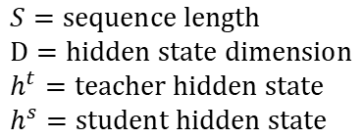
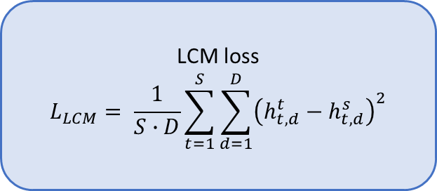
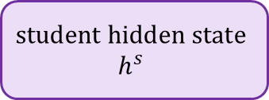
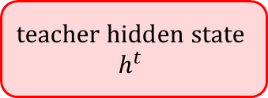
Part3: Proposed method
Latent Consistency Matching
LCM 不直接對齊 softmax probability distribution，而是在 latent / hidden representation 層級對齊 teacher 與 student。
$$\text{teacher} \text{hidden} \text{state}$$
$$h^{t}$$
LCM loss
$$L_{LCM}= \frac{1}{S∙D}\sum_{t=1}^{S}{\sum_{d=1}^{D}{{\left(h_{t,d}^{t}−h_{t,d}^{s}\right)}^{2}}}$$
$$\text{student} \text{hidden} \text{state}$$
$$h^{s}$$
h_t = model.head[0](d).last_hidden_state.detach()
c = confidence(t)
for i in range(1,n):
h_s = model.head[i](d).last_hidden_state
lcm_loss = (h_t - h_s).pow(2).mean().mean()
total_loss += lcm _loss
$$S=\text{sequence} \text{length}$$
$$D=\text{hidden} \text{state} \text{dimension}$$
$h^{t}=\text{teacher} \text{hidden} \text{state}$
$$h^{s}=\text{student} \text{hidden} \text{state}$$
15

Slide 16
Experiment results
FOUR
16

Slide 17
Part4: Experiment results
Evaluation metrics
Metric | Definition | 備註
Oracle PPL head 1~K | 各 head 在 token prediction 上的 perplexity
Avg Draft Token Accepted | 不同 prefix(prompt) length 下的 accepted tokens per forward | prefix length 從1~1024依次遞增加總取平均
Avg Draft Tokens Accepted vs. Prefix Length | 不同 prefix(prompt) length 下的 accepted tokens per forward | 128, 256, 512, 768 length with random continue slicing
Generative PPL | 生成文字由外部 LM 評估的 perplexity | LM使用gpt2-large, 生成200 response
Entropy | 生成分佈的不確定性 / 多樣性指標 | 生成200 response
4-gram repetition | 生成文字重複程度 | 生成200 response
17

Slide 18
Part4: Experiment results
Formal 1.3B comparison — SDC+LCM vs. baseline. Oracle PPL
10B token for training model
Metric | SDC+LCM | baseline | Improvement
PPL head 1 | 19.1695 | 19.4293 | 1.34%
PPL head 2 | 83.7266 | 87.2351 | 4.02%
PPL head 3 | 189.2825 | 200.0813 | 5.40%
PPL head 4 | 299.5625 | 318.3247 | 5.89%
18

Slide 19
Part4: Experiment results
Formal 1.3B comparison — SDC+LCM vs. baseline. Avg Draft Tokens Accepted
10B token for training model
Metric | SDC+LCM | baseline | Improvement
Avg Draft Tokens Accepted | 0.7302 ± 0.0000 | 0.7010 ± 0.0000 | 4.17%
Prefix 128 | 0.9653 ± 0.0401 | 0.9117 ± 0.0205 | 5.88%
Prefix 256 | 0.9873 ± 0.0063 | 0.9458 ± 0.0068 | 4.39%
Prefix 512 | 1.0158 ± 0.0309 | 0.9689 ± 0.0221 | 4.84%
Prefix 768 | 1.0272 ± 0.0250 | 0.9760 ± 0.0222 | 5.25%
19

Slide 20
Part4: Experiment results
Formal 1.3B comparison — SDC+LCM vs. baseline. Generative quality
10B token for training model
Metric | SDC+LCM | baseline | Improvement
Generative PPL | 18.7180 ± 0.8276 | 39.5580 ± 0.9425 | 52.68%
Entropy | 6.8620 ± 0.0202 | 7.3223 ± 0.0351 | 6.29%
4-gram repetition | 0.0526 ± 0.0147 | 0.0229 ± 0.0084 | -130.17%
20

Slide 21
Part4: Experiment results
Formal 1.3B comparison — SDC+LCM vs. baseline. Zero-shot PPL improvement by head
10B token for training model
Dataset | Head 1 | Head 2 | Head 3 | Head 4 | Observation
Wikitext | 0.32% | 7.57% | 7.19% | 5.62% | consistency mainly improves distant draft prediction.
PTB | 13.82% | 9.90% | 10.53% | 5.63% | regular syntax leads to gains across all heads.
Lambada | 38.53% | 10.43% | 4.44% | 3.27% | strong context dependence produces the largest Head 1 gain.
Arxiv | 1.48% | 3.94% | 3.71% | 0.27% | domain-specific knowledge limits improvement.
PubMed | 7.04% | 7.76% | 8.33% | 8.26% | structured biomedical writing provides stable gains across heads.
21

Slide 22
Part4: Experiment results
Ablation study — Oracle PPL
1B token for training model
Setting | Head 1 PPL | Head 2 PPL | Head 3 PPL | Head 4 PPL
baseline | 26.2356 ± 0.0000 | 121.8033 ± 0.0000 | 269.2450 ± 0.0000 | 406.6959 ± 0.0000
S_{W}=1.0, τ=0.0, L_{W}=0.0 | 26.7541 ± 0.0000 | 120.6687 ± 0.0000 | 261.6664 ± 0.0000 | 394.6503 ± 0.0000
S_{W}=1.0, τ=0.3, L_{W}=0.0 | 26.8150 ± 0.0000 | 120.5276 ± 0.0000 | 261.9479 ± 0.0000 | 394.7055 ± 0.0000
S_{W}=1.0, τ=0.6, L_{W}=0.0 | 27.7396 ± 0.0000 | 129.2922 ± 0.0001 | 278.8881 ± 0.0000 | 417.5874 ± 0.0000
S_{W}=1.5, τ=0.3, L_{W}=0.0 | 27.2684 ± 0.0000 | 122.5244 ± 0.0000 | 264.6119 ± 0.0000 | 397.3106 ± 0.0000
S_{W}=0.5, τ=0.3, L_{W}=0.0 | 26.4587 ± 0.0000 | 120.7186 ± 0.0000 | 265.0660 ± 0.0000 | 402.0413 ± 0.0000
S_{W}=0.0, τ=0.0, L_{W}=0.5 | 25.7096 ± 0.0000 | 118.9247 ± 0.0000 | 262.1637 ± 0.0000 | 397.9911 ± 0.0000
S_{W}=0.0, τ=0.0, L_{W}=1.0 | 25.5312 ± 0.0000 | 118.5823 ± 0.0000 | 261.1872 ± 0.0000 | 395.1838 ± 0.0000
S_{W}=0.0, τ=0.0, L_{W}=1.5 | 25.4583 ± 0.0000 | 119.1595 ± 0.0000 | 263.2083 ± 0.0000 | 398.8679 ± 0.0000
S_{W}=1.0, τ=0.3, L_{W}=0.5 | 26.2402 ± 0.0000 | 118.2168 ± 0.0000 | 257.0344 ± 0.0000 | 387.7455 ± 0.0000
S_{W}=1.0, τ=0.3, L_{W}=1.0 | 26.4553 ± 0.0000 | 119.2975 ± 0.0000 | 258.4100 ± 0.0000 | 390.7829 ± 0.0000
S_{W}=1.5, τ=0.3, L_{W}=1.0 | 26.5485 ± 0.0000 | 118.4341 ± 0.0000 | 254.9612 ± 0.0000 | 383.7626 ± 0.0000
Let S_{W}, τ, and L_{W} denote the SDC term weight, confidence threshold, and LCM term weight, respectively.
22

Slide 23
Part4: Experiment results
Ablation study — Avg Draft Tokens Accepted
1B token for training model
Setting | Avg Draft Token Accepted | Prefix 128 | Prefix 256 | Prefix 512 | Prefix 768
baseline | 0.6238 ± 0.0000 | 0.8251 ± 0.0140 | 0.8205 ± 0.0062 | 0.8519 ± 0.0195 | 0.8552 ± 0.0233
S_{W}=1.0, τ=0.0, L_{W}=0.0 | 0.6388 ± 0.0000 | 0.8374 ± 0.0165 | 0.8746 ± 0.0108 | 0.8736 ± 0.0158 | 0.8802 ± 0.0029
S_{W}=1.0, τ=0.3, L_{W}=0.0 | 0.6400 ± 0.0000 | 0.8406 ± 0.0131 | 0.8602 ± 0.0232 | 0.8720 ± 0.0233 | 0.8772 ± 0.0015
S_{W}=1.0, τ=0.6, L_{W}=0.0 | 0.6113 ± 0.0000 | 0.7908 ± 0.0074 | 0.7919 ± 0.0086 | 0.8009 ± 0.0035 | 0.8174 ± 0.0130
S_{W}=1.5, τ=0.3, L_{W}=0.0 | 0.6414 ± 0.0000 | 0.8522 ± 0.0098 | 0.8581 ± 0.0139 | 0.8897 ± 0.0043 | 0.9082 ± 0.0204
S_{W}=0.5, τ=0.3, L_{W}=0.0 | 0.6345 ± 0.0000 | 0.8195 ± 0.0122 | 0.8416 ± 0.0115 | 0.8601 ± 0.0065 | 0.8644 ± 0.0304
S_{W}=0.0, τ=0.0, L_{W}=0.5 | 0.6398 ± 0.0000 | 0.8517 ± 0.0156 | 0.8589 ± 0.0096 | 0.8794 ± 0.0050 | 0.8895 ± 0.0257
S_{W}=0.0, τ=0.0, L_{W}=1.0 | 0.6442 ± 0.0000 | 0.8491 ± 0.0130 | 0.8698 ± 0.0154 | 0.8919 ± 0.0168 | 0.8943 ± 0.0012
S_{W}=0.0, τ=0.0, L_{W}=1.5 | 0.6467 ± 0.0000 | 0.8510 ± 0.0112 | 0.8862 ± 0.0054 | 0.8951 ± 0.0129 | 0.9028 ± 0.0327
S_{W}=1.0, τ=0.3, L_{W}=0.5 | 0.6507 ± 0.0000 | 0.8498 ± 0.0339 | 0.8615 ± 0.0179 | 0.8987 ± 0.0103 | 0.8862 ± 0.0151
S_{W}=1.0, τ=0.3, L_{W}=1.0 | 0.6495 ± 0.0000 | 0.8402 ± 0.0209 | 0.8612 ± 0.0043 | 0.8879 ± 0.0157 | 0.8950 ± 0.0071
S_{W}=1.5, τ=0.3, L_{W}=1.0 | 0.6525 ± 0.0000 | 0.8590 ± 0.0101 | 0.8656 ± 0.0214 | 0.9023 ± 0.0277 | 0.9044 ± 0.0140
Let S_{W}, τ, and L_{W} denote the SDC term weight, confidence threshold, and LCM term weight, respectively.
23

Slide 24
Part4: Experiment results
Ablation study — Generative quality
1B token for training model
Setting | Generative PPL | Entropy | 4-gram repetition
baseline | 83.8285 ± 5.1409 | 7.4068 ± 0.0461 | 0.0119 ± 0.0097
S_{W}=1.0, τ=0.0, L_{W}=0.0 | 68.0596 ± 4.5760 | 7.3141 ± 0.0519 | 0.0193 ± 0.0154
S_{W}=1.0, τ=0.3, L_{W}=0.0 | 26.3414 ± 0.3656 | 6.7567 ± 0.0016 | 0.0460 ± 0.0160
S_{W}=1.0, τ=0.6, L_{W}=0.0 | 28.2332 ± 1.2754 | 6.7789 ± 0.0178 | 0.0393 ± 0.0080
S_{W}=1.5, τ=0.3, L_{W}=0.0 | 31.8082 ± 0.4503 | 6.8248 ± 0.0353 | 0.0485 ± 0.0159
S_{W}=0.5, τ=0.3, L_{W}=0.0 | 52.7654 ± 2.2732 | 7.1490 ± 0.0335 | 0.0323 ± 0.0169
S_{W}=0.0, τ=0.0, L_{W}=0.5 | 26.2091 ± 1.5675 | 6.8576 ± 0.0374 | 0.0555 ± 0.0204
S_{W}=0.0, τ=0.0, L_{W}=1.0 | 24.0955 ± 3.2440 | 6.7935 ± 0.0828 | 0.0657 ± 0.0388
S_{W}=0.0, τ=0.0, L_{W}=1.5 | 29.9033 ± 0.5373 | 6.8644 ± 0.0249 | 0.0215 ± 0.0049
S_{W}=1.0, τ=0.3, L_{W}=0.5 | 21.4788 ± 0.0773 | 6.6876 ± 0.0421 | 0.0720 ± 0.0062
S_{W}=1.0, τ=0.3, L_{W}=1.0 | 26.3414 ± 0.3656 | 6.7567 ± 0.0016 | 0.0460 ± 0.0160
S_{W}=1.5, τ=0.3, L_{W}=1.0 | 25.7832 ± 1.6338 | 6.7177 ± 0.0455 | 0.0453 ± 0.0197
Let S_{W}, τ, and L_{W} denote the SDC term weight, confidence threshold, and LCM term weight, respectively.
24

Slide 25
Conclusion
FIVE
25

Slide 26
Part5: Conclusion
Conclusion
本研究在 MTP 架構中加入 SDC 與 LCM，不改變 backbone 即能改善 draft head 品質。
正式 1.3B_4 比較中，SDC+LCM 使 Head 1~4 PPL 全部下降，且 Head 4 降幅達 5.89%。
token accept rate 從 0.7010 提升到 0.7302，代表 self-speculative decoding 有更好的接受潛力。
Generative PPL 從 39.5580 大幅降至 18.7180，顯示生成品質改善最明顯。
核心訊息：consistency-based training 能有效降低 draft heads 的分佈漂移，使 semi-autoregressive generation 更穩定。
26

Slide 27
Part5: Conclusion
Future work & references
進一步測試不同模型規模、更多資料量、不同種類資料集。
繼續下一步訓練計畫如Continue training、SFT
餵進更多資料量後補上 greedy self-speculative decoding 的實際 speed-up 與 oracle speed test 對照。
27

